Slide 1
Exploratory Data Analysis on TCP Metrics
Aaron Kruchten
Mentors: Bryan Learn and Chris Rapier

Slide 2
Learning Objectives
Become familiar with exploratory data analysis techniques
Learn how to clean messy data
When to impute missing values
Recognizing when data is not useful and when it is appropriate to throw it out

Slide 3
Methods
Most analysis was done with R/R studio
Data was stored in an influx DB database.
An open source database built specifically for time series data
Techniques Used Include
Dimension Reduction: PCA
Regression Analysis: Linear/nonlinear and nonparametric
Clustering/Unsupervised Learning: K-means, Spectral, Hierarchical
Causal Discovery Algorithms: PC algorithm with disCItest

Slide 4
Results/Discussion
Data detailing the performance of two data transfer nodes BR33 and BR34.
Data is measured approximately once every minute and records about 140 different metrics concerning flow performance listed in RFC 4898
Data is larger than 60 gigabytes and contains measurements of approximately 377 thousand flows and 842 million data points.
We were primarily concerned with the following measurements
HCDataOctetsOut, OctetsRetrans, HCDataOctetsIn, ElapsedSecs, CurMSS, PipeSize, MaxPipeSize, CurRTO, CongSignals, CurCwnd, CurSsthresh, Timeouts, CurRwinSent, MaxRwinSent, ZeroRwinSent, CurRwinRcvd,MaxRwinRcvd,MaxRwinRcvd, ZeroRwinRcvd
We did many different kinds of analysis. I will now summarize some of the most interesting things I did over the summer.

Slide 5
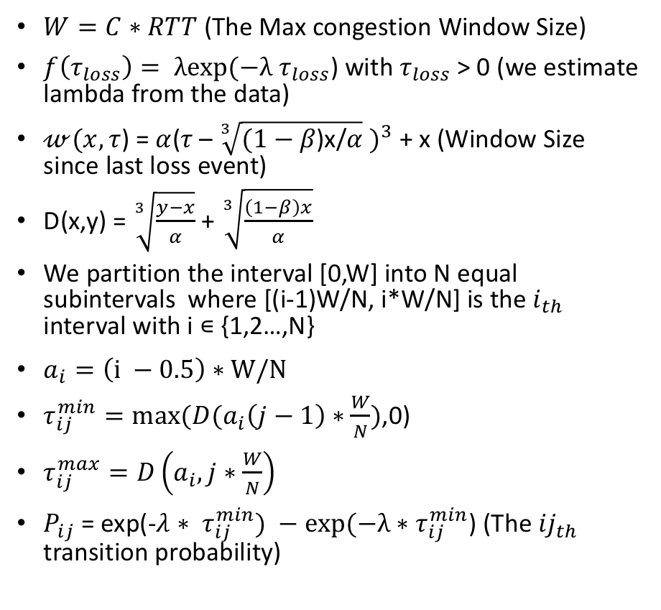
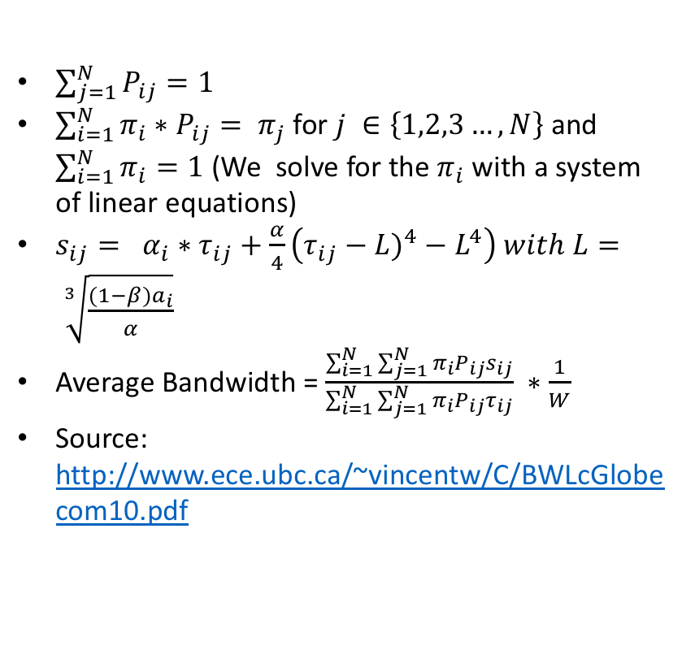
Steady State Throughput Model for TCP Cubic
$W=C∗RTT$ (The Max congestion Window Size)
$f\left(τ_{loss}\right)= λexp(−λ$ $τ_{loss}$) with $τ_{loss}$ > 0 (we estimate lambda from the data)
$𝓌(x,τ$) = $α{\text{(}τ\text{ – }\sqrt[3]{(1−β\text{)}\text{x}\text{/}α} )}^{3}$ + x (Window Size since last loss event)
D(x,y) = $\sqrt[3]{\frac{y−x}{α}}$ + $\sqrt[3]{\frac{\left(1−β\right)x}{α}}$
We partition the interval [0,W] into N equal subintervals where [(i-1)W/N, i*W/N] is the $i_{th}$ interval with i ∊ {1,2…,N}
$a_{i}=\left(i −0.5\right)∗W/N$
$τ_{ij}^{min}=max⁡(D(a_{i}\left(j−1\right)∗\frac{W}{N})$,0)
$τ_{ij}^{max}=D\left(a_{i},j∗\frac{W}{N}\right)$
$P_{ij}$ = exp(-$λ$ ${∗ τ}_{ij}^{min}) −exp(−λ∗τ_{ij}^{min}$) (The ${ij}_{th}$ transition probability)
$\sum_{j=1}^{N}{P_{ij}=1}$
$\sum_{i=1}^{N}{π_{i}∗P_{ij}= π_{j}}$ for $j ∈\left\{1,2,3…,N\right\}$ and $\sum_{i=1}^{N}{π_{i}=1}$ (We solve for the $π_{i}$ with a system of linear equations)
$s_{ij}= α_{i}∗τ_{ij}+\frac{α}{4}\left({τ_{ij}−L)}^{4}−L^{4}\right) with L= \sqrt[3]{\frac{(1−β)a_{i}}{α}}$
Average Bandwidth = $\frac{\sum_{i=1}^{N}{\sum_{j=1}^{N}{π_{i}P_{ij}s_{ij}}}}{\sum_{i=1}^{N}{\sum_{j=1}^{N}{π_{i}P_{ij}τ_{ij}}}} ∗\frac{1}{W}$
Source: http://www.ece.ubc.ca/~vincentw/C/BWLcGlobecom10.pdf
All these formulas depend on the lambda value computed from the data which depends on the exponential distribution assumption we will talk about.

Slide 6
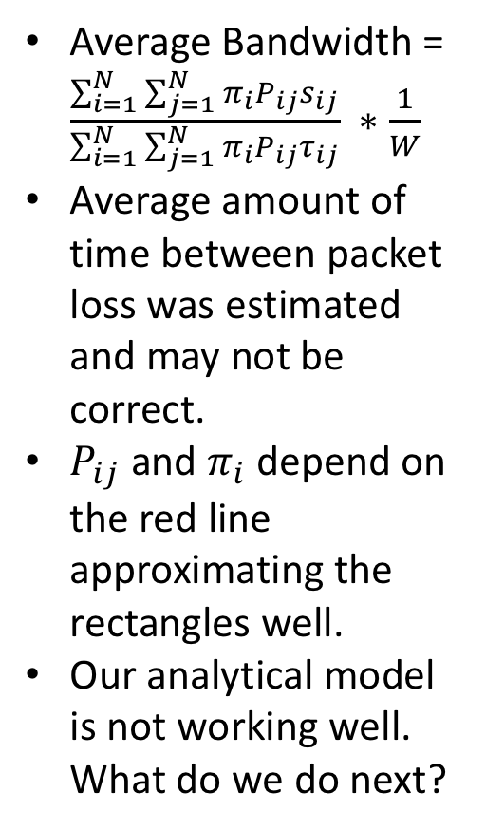
Exponential Distribution Assumption
Average Bandwidth = $\frac{\sum_{i=1}^{N}{\sum_{j=1}^{N}{π_{i}P_{ij}s_{ij}}}}{\sum_{i=1}^{N}{\sum_{j=1}^{N}{π_{i}P_{ij}τ_{ij}}}} ∗\frac{1}{W}$
Average amount of time between packet loss was estimated and may not be correct.
$P_{ij}$ and $π_{i}$ depend on the red line approximating the rectangles well.
Our analytical model is not working well. What do we do next?

Slide 7
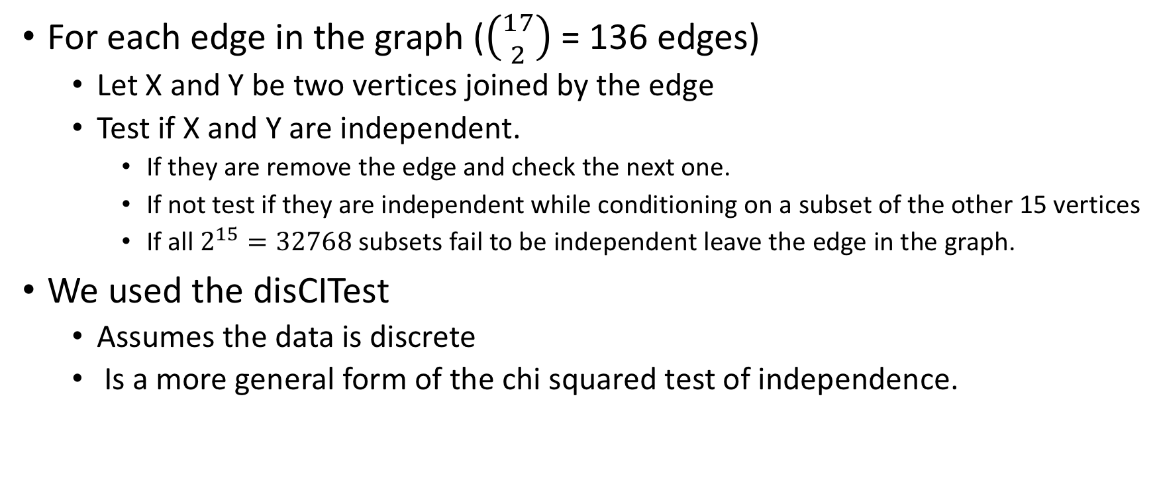
PC Algorithm
For each edge in the graph ($\left({17 \atop 2}\right)$ = 136 edges)
Let X and Y be two vertices joined by the edge
Test if X and Y are independent.
If they are remove the edge and check the next one.
If not test if they are independent while conditioning on a subset of the other 15 vertices
If all $2^{15}=32768$ subsets fail to be independent leave the edge in the graph.
We used the disCITest
Assumes the data is discrete
Is a more general form of the chi squared test of independence.

Slide 8
Directed acyclic graph (DAG)
Causal graph formed on a random sample of about 2000 flows
About 500 megabytes of data were used
Took 3 hours and 20 minutes to complete
Can be parallelized

Slide 9
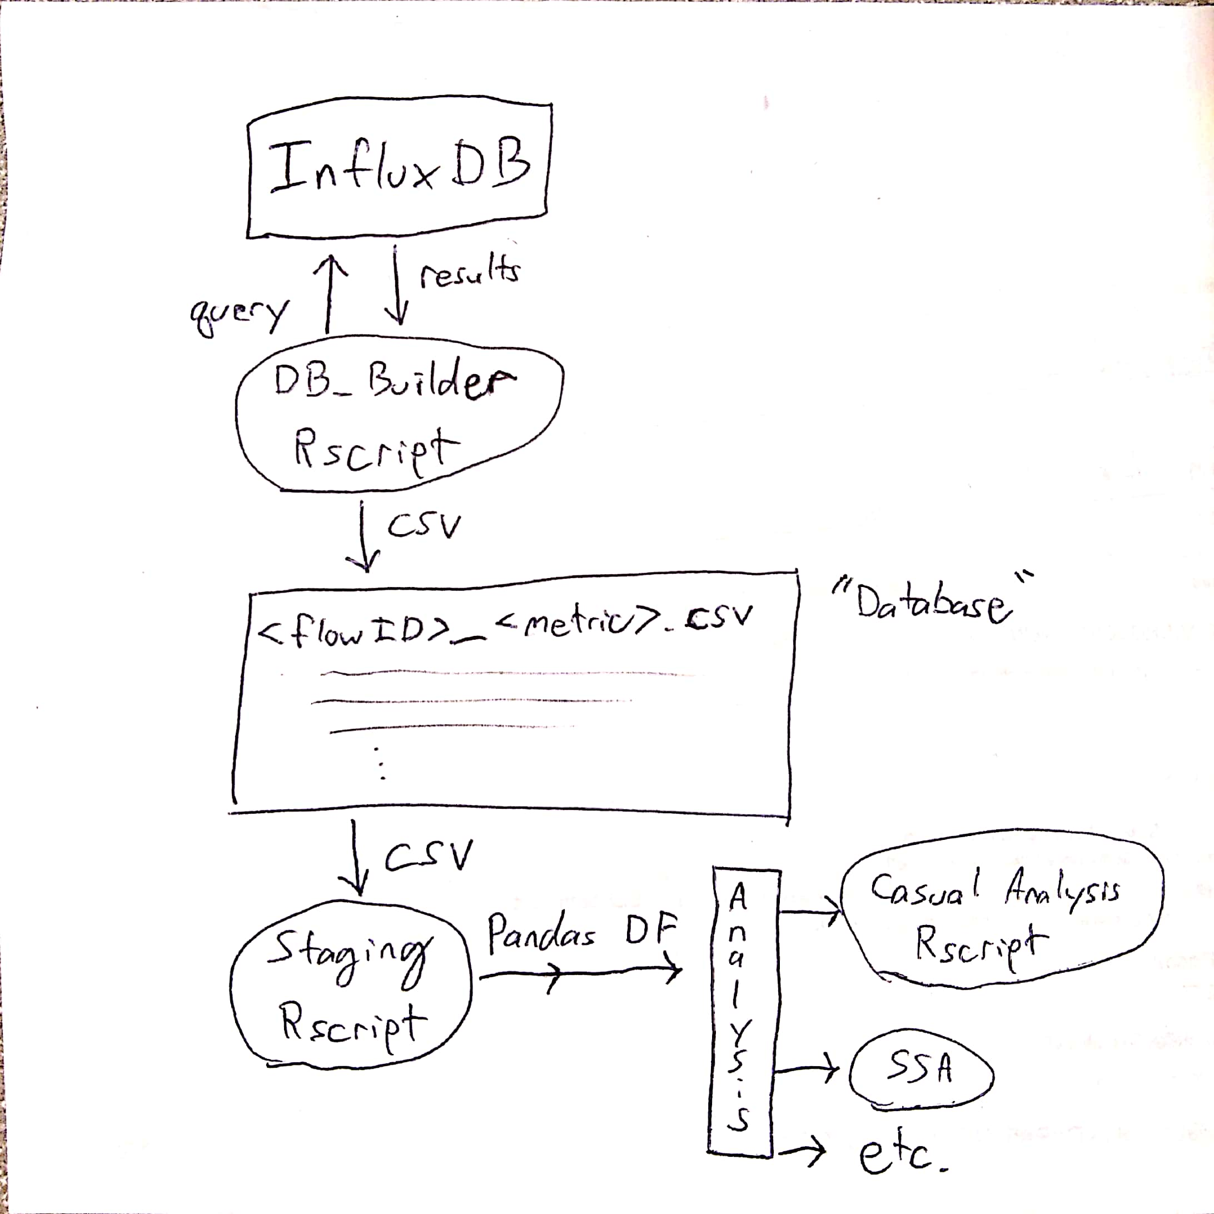
What did we gain from this?
An interface in R that will allow future researchers to easily analyze the data if they want to.
Can easily be converted to a pandas data frame for analysis in Python
https://github.com/AaronKruchten/PSC-EDA

Slide 10
What did we gain from this?
Our Causal analysis verified known facts.
Because of this we are confident that we can use the same algorithms to discover future causalities we are not aware of.
Code can be easily modified in the future to answer research questions that may come up.

Slide 11
Acknowledgement
Bryan Learn
Chris Rapier

